Slide 1
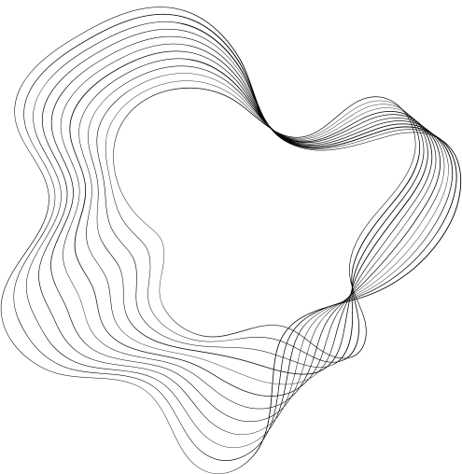


THREAD SYNCHRONIZATION
BUT YUSUPOV ARMAN HAS NOTHING TO DO WITH THESE STREAMS
Lecturer: PhD, Associate Professor
Makpal Zhartybayeva

Slide 2
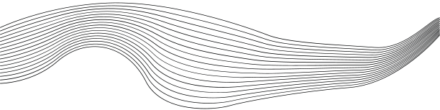
CONTENT
01
SYNCHRONIZATION
02
HARDWARE-SOFTWARE IMPLEMENTATION OF SYNCHRONIZATION
03
BASIC PRIMITIVES:
MUTEXES,
CRITICAL SECTIONS,
EVENTS,
SEMAPHORES
04
MUTUALLY EXCLUSIVE ACCESS TO VARIABLES: ATOMIC OPERATIONS
05
DEADLOCKS

Slide 3




SYNCHRONIZATION
Synchronization is a mechanism that ensures the coordinated execution of actions and prevents conflicts when accessing shared resources (such as memory, files, or I/O devices) in multithreaded or multitasking systems. It addresses two primary objectives:
Preventing data races:
Ordering execution:

Slide 4

Why is synchronization needed in the first place?
The problem appears where there is a shared resource
Two streams. One counter.
Why?
counter = 100
Thread A: counter++
Thread B: counter++
1 READ counter = 100
2 READ counter = 100
3 WRITE 101
Expected: 102
4 WRITE 101
We can get: 101
Race condition: the result depends on interleaving

Slide 5

not to "accelerate," but to streamline
Synchronization defines the rules for access and waiting.
Mutual exclusion
Signaling
Who is allowed to enter now?
When can we continue?
Quantity limit
Atomicity
How many participants are allowed?
Is it possible to make the operation indivisible?
System programming • Windows synchronization

Slide 6


SOFTWARE IMPLEMENTATION OF SYNCHRONIZATION
IMPLEMENTED WITH THE HELP OF PRIMITIVES
CRITICAL SECTIONS
MUTEX
SEMAPHORE
are used to restrict thread access to specific sections of code, ensuring their atomic execution.
FIFOs are designed to lock a resource so that only one thread can use it. FIFOs are in a signaled state when free.
provide access control to a limited number of resources, allowing multiple threads to simultaneously use a resource within certain limits.
CONDITION
BARRIER
ATOMIC OPERATIONS
It is a synchronization primitive that allows threads to wait until a certain condition is met.
It is a synchronization primitive that allows a group of threads to wait for each other until all threads have reached a certain point of execution.
These are low-level operations that are performed atomically, that is, indivisibly
FUTURE/PROMISE
READ/WRITE LOCK
EVENTS
It is a synchronization mechanism that allows one thread to pass the result of a computation to another thread, which will wait for that result.
This is a type of lock that separates access to a resource into read and write operations.
allow threads (and sometimes processes) to wait for a specific event to occur or for a state change to occur before continuing execution.

Slide 7



HARDWARE IMPLEMENTATION OF SYNCHRONIZATION
IMPLEMENTED WITH THE HELP OF SPECIAL COMMANDS/INSTRUCTIONS
tas
(test and set)
xchg (exchange)

Slide 8


CRITICAL SECTION
  Critical sections are a synchronization mechanism used to control access to shared resources in multithreaded programming.
  Key Features
atomicity
performance
Limiting the scope of action
InitializeCriticalSection: Initializes the critical section object.
EnterCriticalSection: Enters a critical section and blocks other threads from entering that section.
LeaveCriticalSection: Releases the critical section, allowing other threads to enter it.
DeleteCriticalSection: Deletes the critical section object and frees its resources.

Slide 9
Critical Section
The easiest "turnstile" within a single process
ONE PROCESS
• Only threads of one process
• Usually faster than mutex
• Owner - thread
• Recursive input is allowed
• Enter → work → Leave
Process
T1
CRITICAL SECTION
T2
shared data
T3
System programming • Windows synchronization

Slide 10


MUTEX
A critical section is a local door. A mutex is a door that can be shared between different processes.
used to solve the problem of mutual exclusion between parallel threads running in different process contexts
FREE
CASH REGISTER!!!!
  Key Features
Access exception: a mutex serves only one thread
Locking and unlocking: A thread must acquire a mutex before accessing it and release it after accessing the shared resource.
Recursivity: Some mutexes support recursive access, allowing a single thread to acquire the mutex multiple times without blocking itself.
Interprocess synchronization: Mutex kernel object
  CreateMutex / CreateMutexEx Creates a new mutex or opens an existing one.
  WaitForSingleObject waits for a mutex to be acquired. The thread blocks until the mutex becomes available.
  ReleaseMutex Releases the acquired mutex.
  OpenMutex

Slide 11

SEMAPHORE
  A semaphore is a synchronization primitive used to control access to a limited number of resources or to coordinate actions between threads or processes. A semaphore allows multiple threads or processes to simultaneously access a resource but limits the number of resources they can access.
I'LL LET YOU INTO THE BAR
THE FIRST FIVE
  Main functions
  Count:
  Capture and liberation
  Semaphores can be binary or counting:
Processor synchronization:
FUNCTIONS
CreateSemaphore / CreateSemaphoreEx - create a semaphore
ReleaseSemaphore - release a semaphore by incrementing its value
WaitForSingleObject - acquire a semaphore
OpenSemaphore - open an existing semaphore
SECURITY

Slide 12
Semaphore
Permission counter, not just "closed/open"
Imagine a 3-space parking lot.
1
2
3
T1
T2
T3
T4
count > 0 → entry is allowed and count is decremented. count = 0 → the next thread waits.
System programming • Windows synchronization

Slide 13



EVENT
  Events allow threads or processes to signal each other when certain conditions are met. Events are often used to coordinate work between threads, allowing one thread to notify others when a certain condition is met or an operation is completed.
I'm not a snitch, but I have to report
Main characteristics
Emergency signals
Event Types: Events can be automatic (auto-reset) or manual (no auto-reset).
  Interprocess synchronization:
FUNCTIONS
CreateEvent / CreateEventEx - creates an event.
SetEvent - sets the event to the signaled state.
ResetEvent - sets the event to a non-signaled state.
WaitForSingleObject - waits for a signal for an event.
PulseEvent - signals that an event is set for a short period of time, after which it returns to the non-signaled state.
OpenEvent

Slide 14
Event
Doesn't protect the resource. Reports: "An event has occurred."
prepares data
SET
Worker
Consumer
WAIT
continues
Manual-reset: remains signaled until ResetEvent. • Auto-reset: skips the waiter and resets automatically.
System programming • Windows synchronization

Slide 15

Atomic Operations
Sometimes the lock is too heavy
Routine operation
Atomic operation
counter++;
// read → modify → write
InterlockedIncrement(&counter);
// one indivisible operation
It can wedge itself between the steps
another stream.
For simple counters/flags
Often Interlocked* is sufficient.
Atomicity ≠ universal lock replacement
System programming • Windows synchronization

Slide 16
Wait functions
Synchronization is also about managing expectations
wait for one object
WaitForSingleObject
wait for several objects
WaitForMultipleObjects
don't wait forever
timeout
DWORD r = WaitForSingleObject(hEvent, 2000); // signaled? timeout? failure?
System programming • Windows synchronization

Slide 17
Deadlock
KESHIKPEY KELEM DEP EҢ, MEN TURMYN ELEҢDEUMEN
Thread A
Resource 1
A is waiting for R1
B is waiting for R2
Resource 2
Thread B
Treatment: single capture order • timeout • decrease lock area • do not hold lock during long operations
System programming • Windows synchronization

Slide 18
Race condition ≠ Deadlock
One mistake gives the wrong result, another - no progress
RACE CONDITION
DEADLOCK
"Who got there first?"
"Everyone is waiting for everyone"
The program works,
but the result depends
from the order of execution.
The program can be
logically correct,
but progress has been halted.
System programming • Windows synchronization

Slide 19
Typical mistake: too big a lock
13
Synchronization can make a parallel program sequential
Badly
Better
EnterCriticalSection(&cs);
ReadFile(...); // long
Compute(...); // long
SendToNetwork(...); // even longer
sharedValue++;
LeaveCriticalSection(&cs);
ReadFile(...);
Compute(...);
SendToNetwork(...);
EnterCriticalSection(&cs);
sharedValue++;
LeaveCriticalSection(&cs);
Lock should protect the general invariant, not the entire world around it.
System programming • Windows synchronization

Slide 20
How to choose a primitive?
14
Quick decision tree
What needs to be synchronized?
Common code/data
Fact of the event
N permissions
Critical
Section
Mutex
Event
Semaphore
1 process cross-process signal
signal cross-process
counter cross-process
System programming • Windows synchronization

